Slide 1
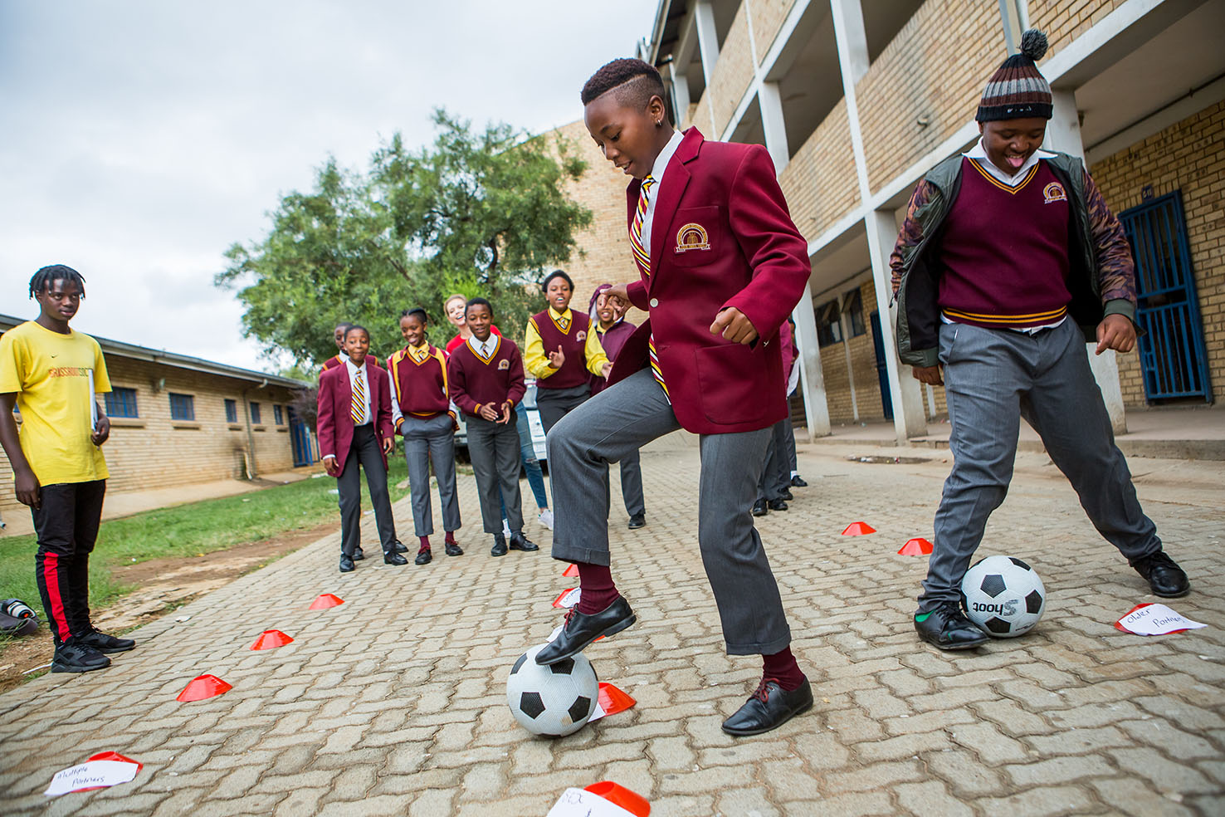



CHANGING THE GAME IN
ADOLESCENT-CENTERED DESIGN:
ASSETS, ACCESS, ADHERENCE
#changingthegame #AIDS2108
Please tag @grassrootsoccer

Slide 2


Breaking the Cycle of Transmission:
Increasing adoption of and adherence to HIV prevention among adolescent girls and young women (AVAC)
and
Increasing uptake of HIV testing, prevention and treatment among young men (PSI)
Changing the Game in Adolescent-Centered Design
International AIDS Conference 2018 Pre-Conference Meeting
Shawn Malone, Joint Project Director
Amsterdam, 22 July 2018

Slide 3
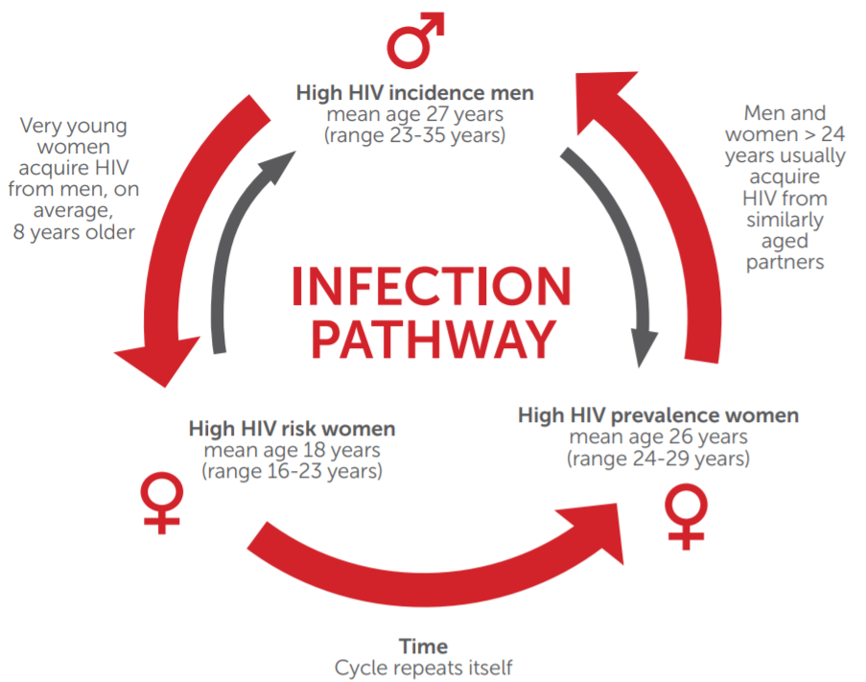
The challenge
Notes:
AVAC & the Prevention Market Manager project aim to increase uptake of and adherence to HIV prevention options—social, behavioral and biomedical—among adolescent girls and young women 15-24.
PSI aims to increase uptake of HIV testing & linkage to treatment for young men 25-34.

Slide 4

The other challenge!
Notes:
In this photo, we could either ask “What is wrong with these walkers who keep taking shortcuts across the grass? How can we make them walk on the pavement? Or we can accept that they prefer to walk where they walk and build the pavement to take that into account.

Slide 5
Research design
Geographic focus
5 districts of KwaZulu-Natal (eThekwini, King Cetshwayo, Ugu, uMgungundlovu, Zululand)
3 districts of Mpumalanga (Ehlanzeni, Gert Sibande, Nkangala)
Demographic focus
Adolescent girls and young women 15-24, sexually active, unprotected sex in the past 3 months, more than one sexual partner in past 12 months or believes partner has other sexual partners
Young men 25-34, sexually active, uncircumcised
Sample sizes
Young men
Ethnography
  18 men, 4 healthcare providers
Qualitative
  58 men, 64 healthcare providers
Quantitative
  2000 men
Adolescent girls and young women
Qualitative:
240 AGYW, 120 “influencers”
Quantitative:
2000 AGYW
Discrete choice experiment:
1000 AGYW

Slide 6
Scope and objectives
Overarching questions
How can we better understand young men’s decisions and behaviours with regard to HIV testing, prevention and treatment?
How can we identify different segments of young men to enable better tailoring/targeting?
How can we reach each segment more effectively with HIV prevention, testing and treatment?
Project phases
User-centred research—talking directly to young people to gain a better understanding of individual, social and structural barriers and enablers
Human-centred design—developing and trying out some new approaches based on what we have learned

Slide 7
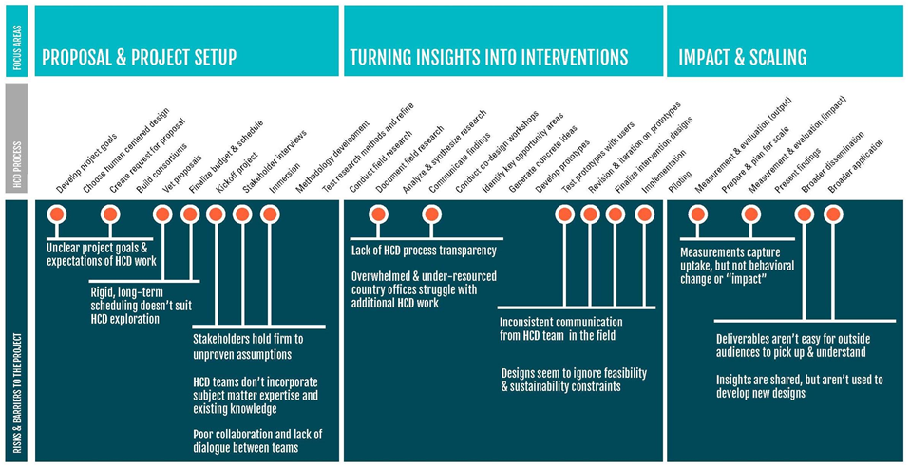
What are the pain points?

Slide 8
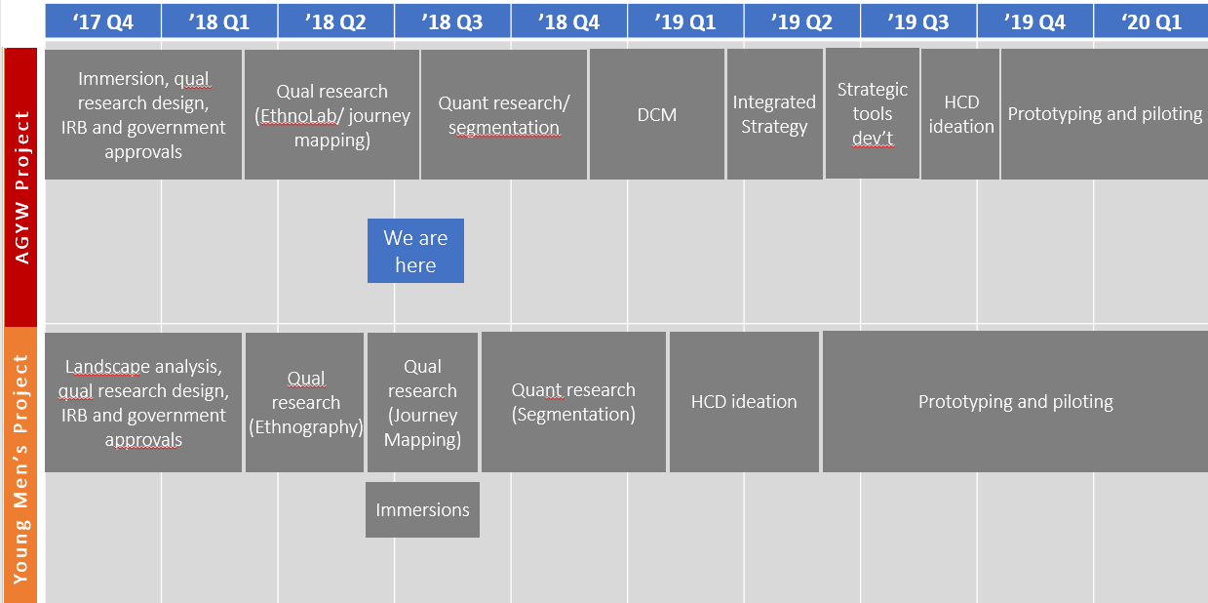
What have we done so far?
We are still very early in the project cycle. We have some early findings, but they are intended to be formative and exploratory rather than definitive or prescriptive.

Slide 9
Young men: What are we learning so far?
Many of these men live with tremendous stress and often trauma. We might not reach them if HIV testing and linkage is yet another burden, rather than a relief.
Many experience cognitive dissonance. Their ideals do not match their behavior. Their aspirations do not match their reality. We might not reach them if we cannot help them navigate and cope with these tensions.
Their attitudes towards relationships and sex are more complicated than we might assume. We might not reach them if our approach does not acknowledge and address these complexities.
Many have no one to go to for advice or support. We might do better in reaching these men if we can identify positive influential relationships in their lives and make it easier for them to seek advice and support.
Fear of disclosure is a significant barrier to testing and treatment. We might drive some men away if we do not approach index case testing and partner notification smartly and sensitively.
There are many immediate costs to testing and treatment but no immediate rewards. We might not reach these men if we cannot change this cost-benefit calculus.
There are gaps in quality of care that cause men to slip through the cracks even when they have sought services. We will lose men unnecessarily if we do not provide services that are consistently in line with existing standards of care.
We sometimes fall into thinking of men as “the problem”, rather than as complex individuals who often come from difficult backgrounds and live under challenging circumstances. We might not reach them unless we come from a place of empathy that seeks to understand the influences and experiences that shape their attitudes, decisions and behaviors.

Slide 10
Adolescent girls and young women: What are we learning so far?
Most AGYW conceptualize HIV in the context of relationship management and preservation, not HIV specifically or even sexual and reproductive health more broadly.
Risk and reward are often a feeling more than a cognitive assessment. Feelings of risk are limited to specific incidents, whereas the relationship rewards of high-risk behavior are continuous. Perceived rewards for safe behavior are almost non-existent.
AGYW often conceptualize HIV prevention in terms of being a “good girl”. Many believe that only someone who has multiple irregular partners (“a different partner every week”) is at risk, while someone with one or even multiple regular partners is not.
Without effective counseling, a negative HIV test result may reinforce high-risk behaviors by “resetting the risk meter” and implicitly communicating that “what I have been doing is working” rather than “I dodged a bullet but now I need a better approach”.
Many AGYW underestimate the burden of living with HIV, feeling that the availability of treatment means that HIV is not something that would significantly affect quality of life.
Reliable, non-judgmental guidance can be hard to find. Peers may empathize with AGYW but are not seen as knowledgeable. Parents and healthcare providers may be knowledgeable but often do not empathize. Male partners are also generally not empathetic.
We sometimes fall into thinking of AGYW as irrational in engaging in high-risk behavior, rather than recognizing how their decisions relate to broader life goals and priorities and finding ways to align and integrate HIV prevention into those goals and priorities.

Slide 11
Disclosures
Funders:
Bill & Melinda Gates Foundation
Maverick Collective
Advisory Board:
Anova Health, Bill & Melinda Gates Foundation, BroadReach, Centre for Communication Impact (CCI), CDC, Clinton Health Access Initiative (CHAI), FHI 360, Foundation for Professional Development (FPD), Global Fund, Health Systems Trust, NACOSA, South African National Department of Health, Right to Care, Society for Family Health (SFH), Sonke Gender Justice, South African National AIDS Council (SANAC), USAID

Slide 12
Acknowledgements
We gratefully acknowledge the guidance and support that we have received from more stakeholders than we have space to mention. Particular thanks to:
National Department of Health
Provincial Departments of Health in KZN and MPU
Premier’s Office/Provincial AIDS Council in KZN and MPU
District teams in Ehlanzeni, eThekwini, Gert Sibande, King Cetshwayo, Nkangala, Ugu, uMgungundlovu and Zululand
South African National AIDS Council (SANAC)
Foundation for Professional Development (research co-sponsor)
Implementing partners including Anova, BroadReach, CCI, CHAI, FHI 360, Health Systems Trust, MatCH, NACOSA, Right to Care, SFH and Sonke.
Research organisations including AHRI, FHI 360, CAPRISA, Epicentre, Genesis Analytics, HSRC, MRC, Pop Council, RTI and WRHI.
Funding agencies including the Bill & Melinda Gates Foundation, CDC, Global Fund, UNITAID and USAID.

Slide 13

THANKS!

Slide 14
CHANGING THE GAME IN
ADOLESCENT-CENTERED DESIGN:
ASSETS, ACCESS, ADHERENCE
#changingthegame #AIDS2108
Please tag @grassrootsoccer

